Slide 1
Letters in the Dust – The Epigraphy, Archaeology and Conservation of Medieval Jewish Cemeteries
(7-8 November 2016, Utrecht University, Utrecht, The Netherlands)
Jewish inscriptions: some criteria
pertinence to contexts otherwise defined as Jewish, for example assembly-buildings, or reserved burial places
- elements of Jewish language and/or writing;
- textual elements pertaining to Jewish praxis:
1. mention of communities (synagogues);
2. recollection of honorific charges or responsibility in the communities;
3. reference to peculiar religious feasts;
4. explicit self-identifications (essentially: Iudaeus, ᾿Ιουδαῖος);
5. typically Jewish names and/or formulae
- identifying figures or images

Slide 2
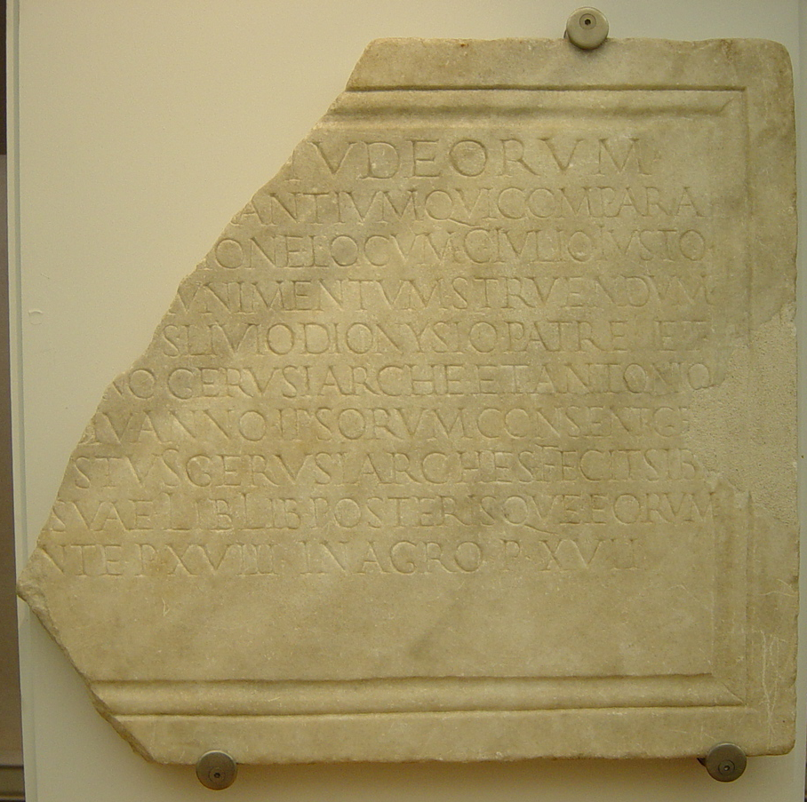
Letters in the Dust – The Epigraphy, Archaeology and Conservation of Medieval Jewish Cemeteries
(7-8 November 2016, Utrecht University, Utrecht, The Netherlands)
Castelporziano (Ostia). Rome, Museo Nazionale delle Terme di Diocleziano.
Donation of a plot of land by the universitas Iudaeorum in order to build the tomb of the gerusiarch C. Iulius Iustus. First half of 2nd cent. CE.
[υniversitas] Iud(a)eorum / [in col(onia) Ost(iensium) commor]antium qui compara/[verunt ex conlat]ione locum C(aio) Iulio Iusto / [gerusiarchae ad m]unimentum struendum / [donavit rogantib]us Livio Dionysio patre et / [---]no gerusiarch(a)e et Antonio / [--- dia b]iu anno ipsorum consent(iente) ge[r]/[us(ia) C(aius) Iul(ius) Iu]stus gerusiarches fecit sib[i] / [et coniugi] suae lib(ertis) lib(ertabusque) posterisque eorum / [in fro]nte p(edes) XVIII in agro p(edes) XVII

Slide 3
Letters in the Dust – The Epigraphy, Archaeology and Conservation of Medieval Jewish Cemeteries
(7-8 November 2016, Utrecht University, Utrecht, The Netherlands)
Jewish inscriptions collected in the main epigraphic corpora (relating to the Roman Empire)
GENERAL DISTRIBUTION
LATE ANTIQUITY

Slide 4
Letters in the Dust – The Epigraphy, Archaeology and Conservation of Medieval Jewish Cemeteries
(7-8 November 2016, Utrecht University, Utrecht, The Netherlands)
Beth She’arim. Acclamatory graffito
(Schwabe – Lifshitz 1974, n. 193).
θαρσῖτε / πατέρες ὅσιοι· / οὐδὶς ἀθάνατος
Be of good courage, pious parents ! No one is immortal.

Slide 5
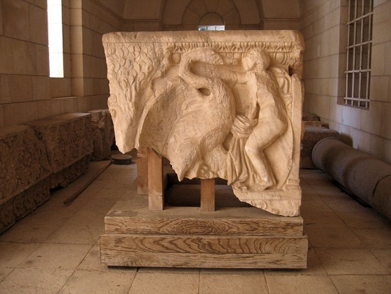
Letters in the Dust – The Epigraphy, Archaeology and Conservation of Medieval Jewish Cemeteries
(7-8 November 2016, Utrecht University, Utrecht, The Netherlands)
Beth She’arim, Galilee, Israel.
Marble sarcophagus with Leda and the swan

Slide 6
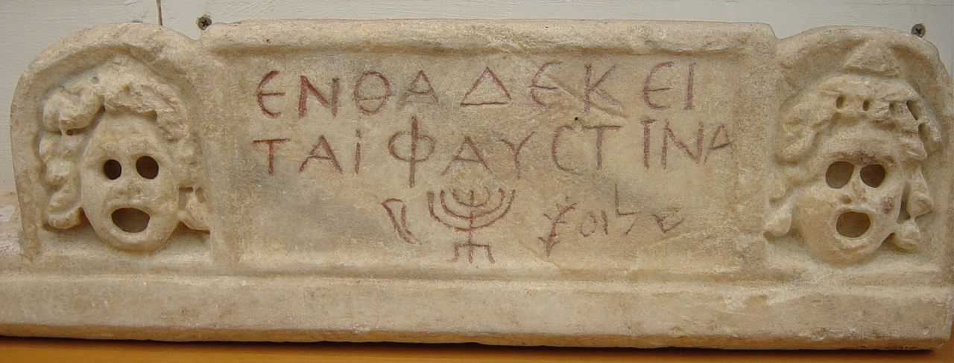
Rome, from porta s. Sebastiano (now in Museo Nazionale delle Terme di Diocleziano)
Sarcophagus of Faustina (JIWE, 2, 535) with Hebrew acclamation (shalom) and the figures of lulav, menorah, shofar.
ἐνθάδε κεῖ/ται Φαυστῖνα ((shofar)) ((menorah)) ((lulav)) שלומ.
Here lies Faustina. Peace.

Slide 7
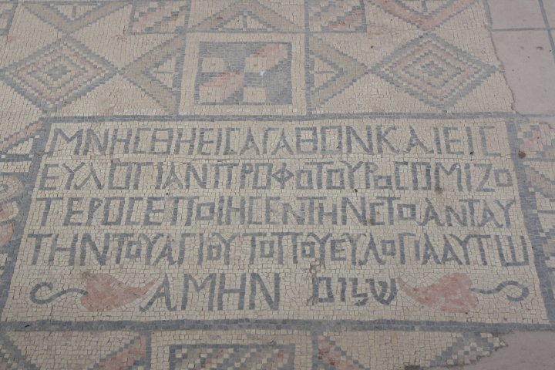
Letters in the Dust – The Epigraphy, Archaeology and Conservation of Medieval Jewish Cemeteries
(7-8 November 2016, Utrecht University, Utrecht, The Netherlands)
Hammath Tiberias, synagogue.
Mosaic inscription in the floor mentioning the building of the porch, with final Hebrew acclamations amen (in Greek writing) and shalom (in Hebrew writing)
4th-5th cent. CE
(See M. Dothan, Hammath Tiberias. Early Synagogues and the Hellenistic and Roman remains, Jerusalem 1983, pp. 60-62, n. 3, pls. 18.1, 21.3; 35.4)

Slide 8
Letters in the Dust – The Epigraphy, Archaeology and Conservation of Medieval Jewish Cemeteries
(7-8 November 2016, Utrecht University, Utrecht, The Netherlands)

Slide 9
Letters in the Dust – The Epigraphy, Archaeology and Conservation of Medieval Jewish Cemeteries
(7-8 November 2016, Utrecht University, Utrecht, The Netherlands)
Venusia, Jewish catacombs
Origin of the names (% on single time-span)

